Slide 1
Twilio Analytics

Slide 2
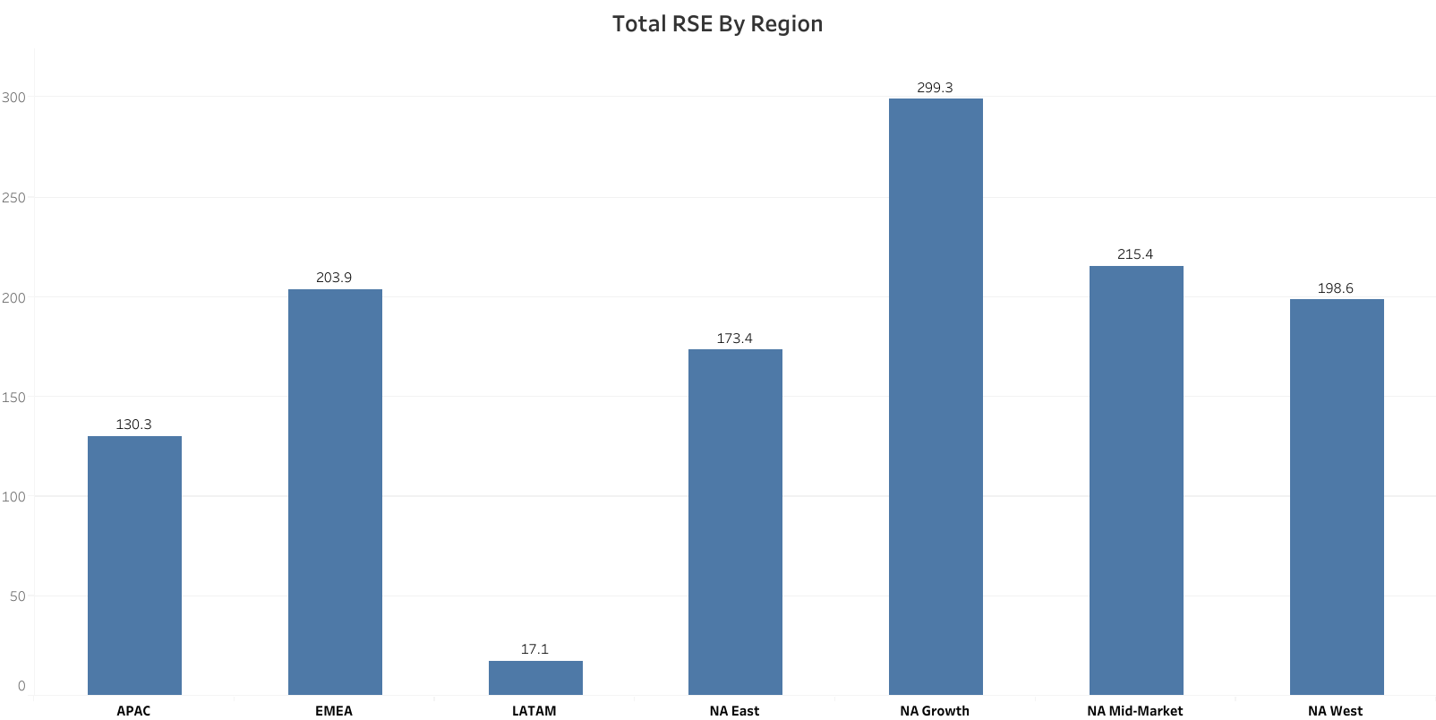
Total RSE By Region
Region | APAC | EMEA | LATAM | NA East | NA Growth | NA Mid-Market | NA West | Grand Total
2020-01 | 16.95 | 26.59 | 1.84 | 26.10 | 44.03 | 29.21 | 29.07 | 173.78
2020-02 | 17.02 | 26.54 | 1.94 | 25.10 | 44.14 | 29.09 | 28.82 | 172.65
2020-03 | 16.83 | 26.41 | 2.09 | 24.93 | 43.99 | 29.24 | 28.82 | 172.31
2020-04 | 26.45 | 41.47 | 3.71 | 32.43 | 55.73 | 42.63 | 37.30 | 239.72
2020-05 | 26.52 | 41.47 | 3.78 | 32.43 | 55.73 | 42.63 | 37.30 | 239.86
2020-06 | 26.52 | 41.47 | 3.78 | 32.43 | 55.73 | 42.63 | 37.30 | 239.86
Grand Total | 130.29 | 203.93 | 17.15 | 173.43 | 299.34 | 215.44 | 198.59 | 1238.18

Slide 3
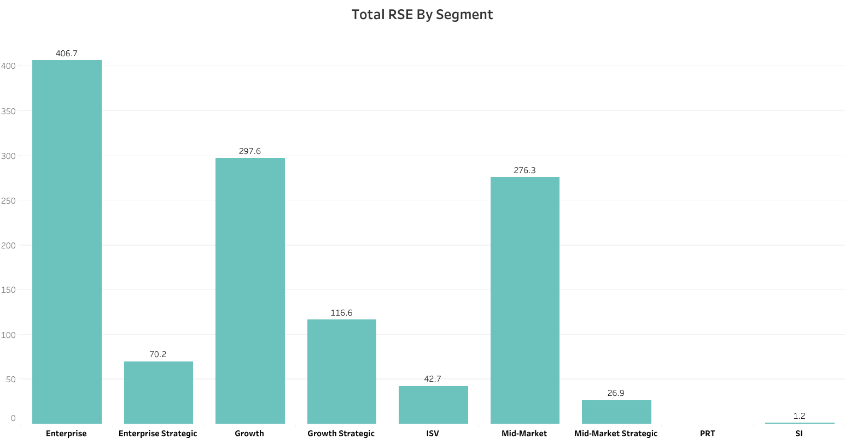
Total RSE By Segment
Segment | Enterprise | Enterprise Strategic | Growth | Growth Strategic | ISV | Mid-Market | Mid-Market Strategic | PRT | SI | Grand Total
2020-01 | 59.58 | 9.96 | 44.03 | 13.83 | 6.58 | 36.86 | 2.54 | 0.00 | 0.40 | 173.78
2020-02 | 58.28 | 9.96 | 44.19 | 13.93 | 6.58 | 36.75 | 2.54 | 0.00 | 0.40 | 172.65
2020-03 | 57.98 | 9.96 | 44.01 | 13.93 | 6.58 | 36.90 | 2.54 | 0.00 | 0.40 | 172.31
2020-04 | 76.95 | 13.45 | 55.16 | 24.96 | 7.65 | 55.13 | 6.42 | 0.00 | 0.00 | 239.72
2020-05 | 76.95 | 13.45 | 55.30 | 24.96 | 7.65 | 55.13 | 6.42 | 0.00 | 0.00 | 239.86
2020-06 | 76.95 | 13.45 | 54.93 | 24.96 | 7.65 | 55.50 | 6.42 | 0.00 | 0.00 | 239.86
Grand Total | 406.70 | 70.22 | 297.62 | 116.58 | 42.70 | 276.28 | 26.88 | 0.00 | 1.20 | 1238.18

Slide 4
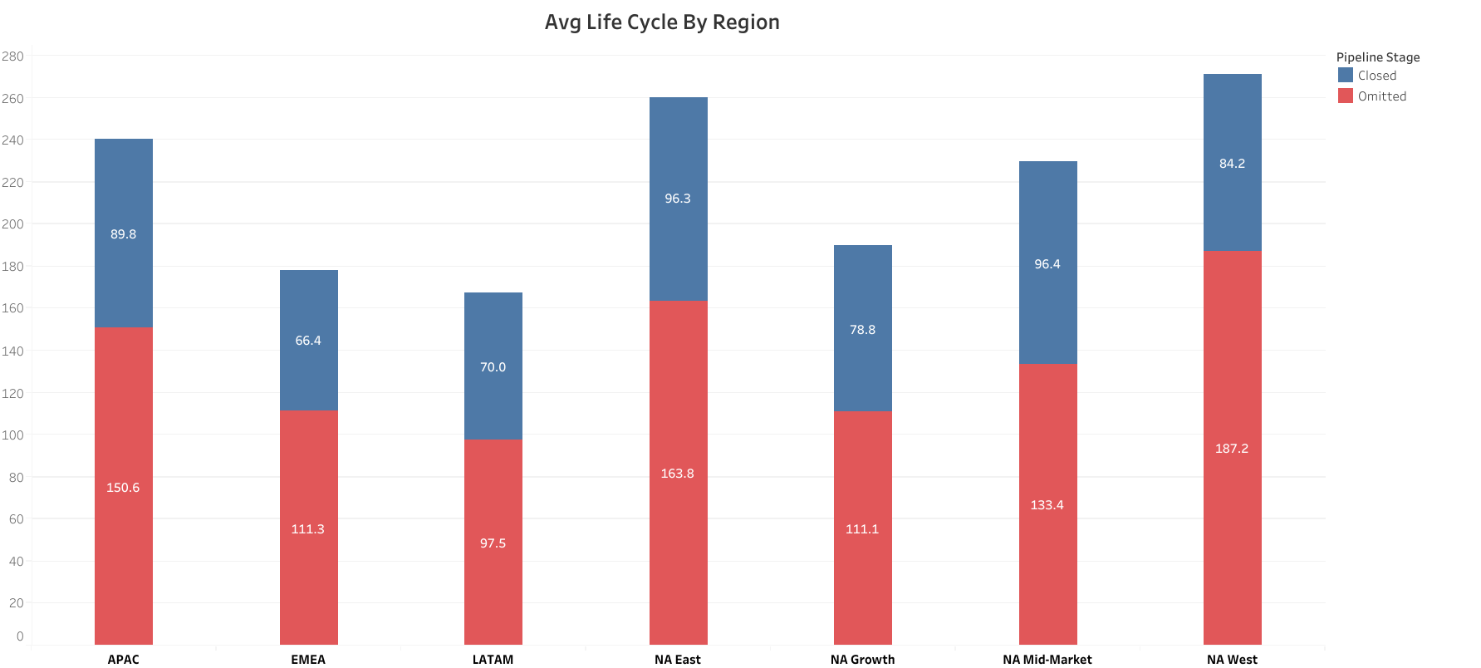
Avg Life Cycle By Region
Region | APAC | EMEA | LATAM | NA East | NA Growth | NA Mid-Market | NA West | Grand Total
Closed | 89.82 | 66.45 | 70.02 | 96.27 | 78.83 | 96.44 | 84.16 | 82.04
Omitted | 150.64 | 111.34 | 97.47 | 163.84 | 111.15 | 133.42 | 187.21 | 127.06
Grand Total | 131.49 | 96.96 | 92.44 | 138.65 | 102.22 | 120.89 | 155.98 | 113.32

Slide 5
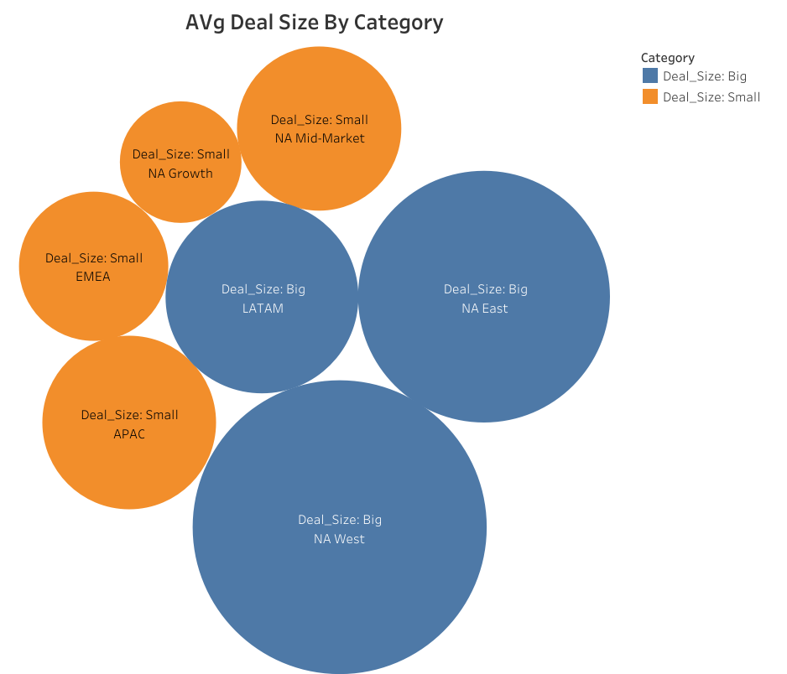
Avg Deal Size By Category
 | Category | Deal_Size: Big | Deal_Size: Small | Grand Total
Region | Pipeline_Stage
APAC | Closed |  | 39094.04 | 39094.04
 | Omitted |  | 46551.77 | 46551.77
EMEA | Closed |  | 42914.50 | 42914.50
 | Omitted |  | 27820.54 | 27820.54
LATAM | Closed | 125328.99 |  | 125328.99
 | Omitted | 38614.51 |  | 38614.51
NA East | Closed | 151908.71 |  | 151908.71
 | Omitted | 57881.99 |  | 57881.99
NA Growth | Closed |  | 40552.62 | 40552.62
 | Omitted |  | 14494.39 | 14494.39
NA Mid-Market | Closed |  | 59207.75 | 59207.75
 | Omitted |  | 29456.72 | 29456.72
NA West | Closed | 151967.15 |  | 151967.15
 | Omitted | 115649.46 |  | 115649.46
Grand Total |  | 98971.53 | 30771.56 | 42367.18

Slide 6
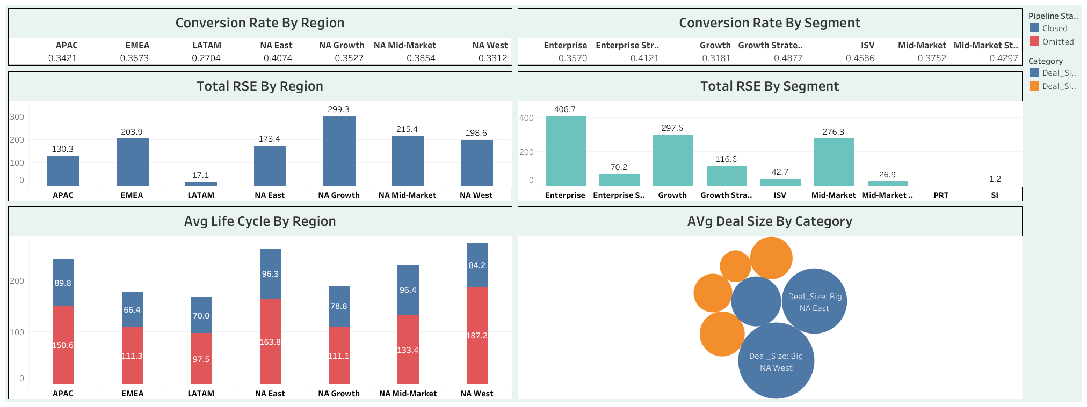
Insight Analysis

Slide 7
Insight Analysis Conclusion
The conversion rates of all the regions range between 0.3 to 0.4 values except Latam.
All the segments conversion rates take these values with Growth strategic having the highest at 0.488.
Most of the regions and segments have good conversion rates since they range between 3% and 5%.
However, Latam has a conversion rate lower than 3% thus I would recommend that more strategies to be put in place in Latam region to improve the conversion rates hence boost the amount of sales.

